Slide 1
how do I become an associate or full professor?
WORKSHOP • Tuesday.January 14.2020 • DFCM 500 University Avenue
Dr Viola Antao, Faculty Development Director, DFCM
Marie Leverman, Academic Promotions Coordinator, DFCM

Slide 2
goals of the workshop
To Identify the criteria, steps, timeline and process for a senior promotion
To understand the components and requirement documents of a (1) prep-application and (2) a senior promotion dossier
To help you look at the academic work you are engaged in
Take home message – Early Do’s & Early Don’ts

Slide 3
Workshop #1 criteria steps timeline & process overview of a: (1) prep-application (2) a senior promotion dossier take home message
Workshop #3
Tuesday May 26.2020
Dedicated only to candidates that have been “supported” to go forward
A letter of application
Reflective statement
Identify internal/external reviewers
Final components of a senior promotion dossier
Workshop #2
Tuesday February 18.2020
Guest facilitators / group tables
This workshop will focus on the senior promotion pre-application package
Overview of scholarly activity in research, CPA, teaching and education
We will assist faculty to identify their five scholarly pieces of work in teaching & education, research, CPA

Slide 4
senior promotion workshop series
In addition to our
three workshops:
We are also pleased to provide three videos of DFCM faculty addressing questions and providing advice on the process of becoming an Associate Professor or full Professor.
Please visit our website:
https://www.dfcm.utoronto.ca/senior-promotion
What has a senior promotion meant to you?
Do you have any advice for others in preparing for a senior promotion?
Who has assisted you in the senior promotion process?

Slide 5
general information
new email address
electronic submission
The senior promotion dossier is prepared and submitted electronically
Candidates receive:
a checklist to follow
USB key with a set file management
naming convention to follow
Academic Promotions Coordinator:
dfcm.promotion@utoronto.ca

Slide 6
what is a senior promotion?

Slide 7
what is a senior promotion?
Senior promotion refers to promotion
to the academic ranks of
Associate Professor and full Professor
Academic promotion in the Faculty of Medicine recognizes the notable achievements of faculty members in their discipline and contributions to the University of Toronto.

Slide 8
what is a senior promotion?
Promotion is not granted as a reward for
long-term service, but rather to recognize those who
have excelled in specific aspects of the
academic mission.
The successful candidate for promotion will be
expected to have established a wide reputation
in his or her field of interest, to be deeply engaged in scholarly work, and to show him or herself
to be an effective teacher.

Slide 9
criteria for a senior promotion

Slide 10
The successful candidate for promotion will be expected to have established a wide reputation in his or her field of interest, to be deeply engaged in scholarly work, and to show him or herself to be an effective teacher.
National recognition for promotion to Associate Professor.
International recognition for promotion to full Professor.
Accomplishments in research, creative professional activity, teaching and education.
The candidate must demonstrate teaching/education activity. Mandatory component of a senior promotion dossier.

Slide 11
You need to demonstrate “excellence” in at least ONE area and “competence” in the other areas.
PLUS 5
significant scholarly pieces of work and/or publications
For example: publications, CPA work, curriculum design, government documents, book/chapters, website development.
Teaching and Education
along with:
Research
and/or
Creative Professional Activity (CPA)
Time is dedicated in Workshop #2

Slide 12
waiver of external review
Do you have sustained “excellence”
in teaching and education?
A Waiver of External Review recognizes the fact that some faculty may spend a large portion of their time in clinical work and teaching as opposed to scholarship (research/CPA) and therefore are not necessarily known nationally or internationally
The Waiver should not be used for a candidate where research/CPA is an important part of the evaluation
Internal referee letters are only solicited
** important **
Identify at the time of meeting with
Dr White & in your pre-application.
Candidates seeking promotion on the basis of EXCELLENCE
in teaching would be
expected to show evidence in
three or more
of these attributes:
Lecturing to large group
Facilitation of small groups
One-to-one teaching
Supervision
Mentoring
PLUS
Mastery of the subject area
Reference:
Manual for Academic Promotion

Slide 14
steps in the senior promotion process

Slide 15
first steps (handout)
Senior Promotion Timeline
Important dates - 2020-2021
Meet with your respective Chief/DFCM Division/Program Director ➔ by March 31.2020
Meet with Dr White ➔ by March 31.2020
Attend the workshops ➔ #2: February 18.2020
Submit a pre-application ➔ by April 3.2020
Place a calendar “hold” for ➔ workshop #3: May 26.2020

Slide 16
senior promotion pre-application + dossier

Slide 17
documents for submitting a pre-application (available on our website)
Required documents:
DUE DATE:
Application Form
Identified areas of excellence and competence
Identified scholarly pieces of work (5)
Curriculum Vitae
Teaching Dossier
Teaching data summary report
Friday April 3.2020
The pre-application is reviewed in Workshop #2
Sample applications will be provided at the Workshop
Time is dedicated in Workshop #2

Slide 18
documents for submitting a senior promotion dossier (handout + next slide)
Required documents:
DUE DATE:
Set documents are required in the areas you have claimed “excellence” or “competece”:
Reporting documents
Teaching & education
plus
Research
and/or
CPA
Administrative service
5 publications/scholarly pieces of work
The week of September 2 – 4
Components of the dossier are reviewed at Workshop #2 and Workshop #3
Sample dossiers will be provided at Workshop #2 and Workshop #3
Time is dedicated in Workshop #3

Slide 19
A Senior Promotion Dossier – Electronic File Management Checklist Department of Family and Community Medicine
 REPORTING DOCUMENTS |  RESEARCH |  CREATIVE PROFESSIONAL ACTIVITY (CPA) |  TEACHING & EDUCATION |  ADMIN SERVICE |  CV & PUBLICATIONS AND OR SCHOLARLY WORK
This folder must include the following files: | If applicable, this folder must include the following files: | If applicable, this folder must include the following files: | This folder must include the following files: | This folder must include the following files: | If applicable, this folder must include the following files:
 Smith_Jane_Application |  Smith_Jane_Research_Stmt |  Smith_Jane_CPA_Stmt |  Smith_Jane_TE_Stmt |  Smith_Jane_Admin_Stmt |  Smith_Jane_ScholaryWork_1
 Smith_Jane_Referee_List |  Smith_Jane_Research_Form |  Smith_Jane_CPA_Letters |  Smith_Jane_TE_Dossier |  Smith_Jane_Admin_Doc |  Smith_Jane_ScholaryWork_2
 |  Smith_Jane_Research_Doc |  Smith_Jane_CPA_Doc |  Smith_Jane_TE_Evaluations |  |  Smith_Jane_ScholaryWork_3
 |  Smith_Jane_H_Index |  |  Smith_Jane_Table7 |  |  Smith_Jane_ScholaryWork_4
 |  Smith_Jane_Table3 |  |  Smith_Jane_Letters |  |  Smith_Jane_ScholaryWork_5
 |  Smith_Jane_Table4 |  |  |  |  Smith_Jane_CV
Letters the DFCM will solicit: |  Smith_Jane_Table5 |  |  |  |  Smith_Jane_Refl_Stmt
 Recommend to the Dean |  |  |  |  |  Smith_Jane_Letter
 Confirmation letter of DPC
 Recommend letter of chief
 Letter of x-appt department
 External reviewer letters
 Student letters
 Waiver of external review
 WORD DOCUMENTS: The following Word documents (in this category) are provided: |  WORD DOCUMENTS: The following Word documents (in this category) are provided: |  WORD DOCUMENTS: The following Word documents (in this category) are provided: |  WORD DOCUMENTS: The following Word documents (in this category) are provided: |  WORD DOCUMENTS: |  WORD DOCUMENTS: The following Word documents (in this category) are provided:
✓ Application form | ✓ Table 3, 4, 5 | n/a | ✓ Table 7 | n/a | ✓ Scholarly work/publication statement form
✓ Referee/Student Form (Excel) | ✓ Publications & research form |  | ✓ Senior promotion colleague letter guidelines |  | ✓ Letter to the chair
 |  |  |  |  | Prepared: January 2020
HANDOUT

Slide 21
take home message

Slide 22
early do’s
Meet with your respective chief/DFCM division director
Secure administrative support (on site or privately)
Book dedicated time
Review and update your CV
Review and update your teaching dossier
Start organizing evidence of your scholarly activities
Keep all your evaluations, letters, emails that speak to the impact of your work (from colleagues)
Collect your TES ➔ chart in data summary table
R E A D the Manual for Academic Promotion

Slide 23
early don’ts
Ask friends or colleagues to serve as an internal or external referee – this is covered in Workshop #3
Approach referees directly
Throw away/delete anything!
Leave your pre-application to the last minute – this is a very time dedicated application process that is critical in the application process

Slide 24
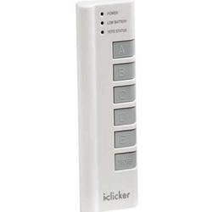
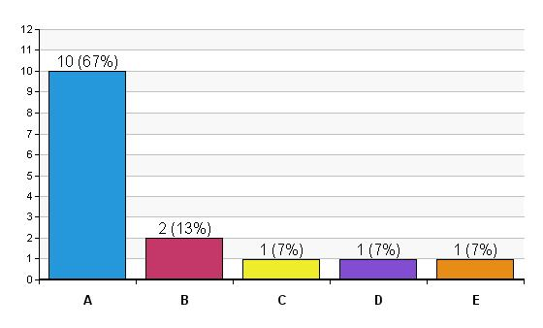
evaluation
please complete
using the iclicker.
test question
Do you have an iclicker?
A - Yes
B - No
C - I would like to win the lottery
D - I would like to win a trip
E - I would like to win a promotion
VOTE STATUS
POWER ON/OFF

Slide 25
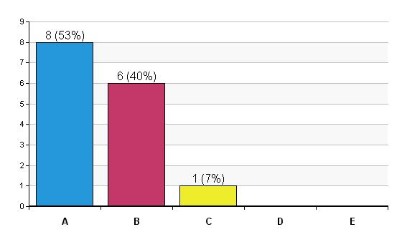
Evaluation SQ #1
I have a better understanding of the criteria and the pathway to success for a senior promotion:
A – Strongly Agree
B – Agree
C – Somewhat
D – Disagree
E – Strongly Disagree

Slide 26
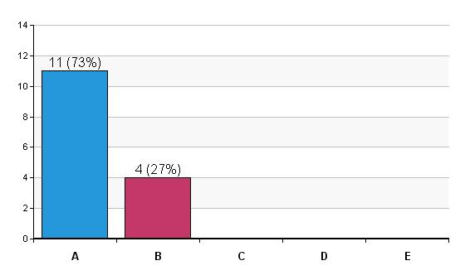
Evaluation SQ #2
I have a better understanding of the steps & timeline for a senior promotion:
A – Strongly Agree
B – Agree
C – Somewhat
D – Disagree
E – Strongly Disagree

Slide 27
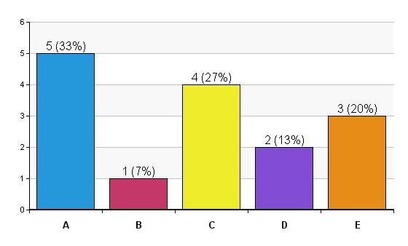
Evaluation SQ #3
I plan on submitting a
pre-application for a senior promotion this year:
A – Strongly Agree
B – Agree
C – Somewhat
D – Disagree
E – Strongly Disagree

Slide 28
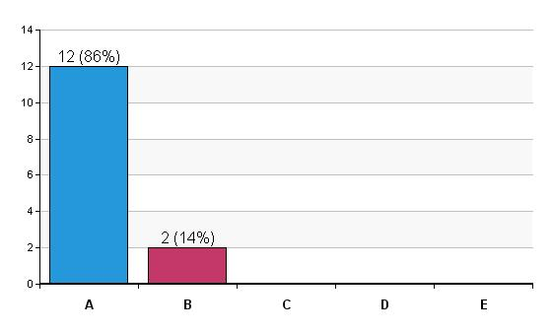
Evaluation SQ #4
Overall, I found the workshop to be:
A – Very informative and helpful
B – Somewhat informative and helpful
C – Okay
D – Just Okay
E – Won’t come again

Slide 29
comment card: please let us know how this workshop will make a difference in preparing for a senior promotion?
I know what is required and the timeline. Very helpful.
Yes, it has clarified steps and processes
Clearly a lot of time and work to go through the process
A lot of information but all very helpful
More organized approach and start early in promotion process. Thank you!

Slide 30
thank you
1
Please turn off the iclicker
2
Please complete the comment card
3
THANK
YOU!

