Slide 1
HOW DO I BECOME AN ASSISTANT PROFESSOR?
JUNIOR PROMOTION INFORMATION SESSION – APRIL 20, 2021
Co-Leads:
Dr. Sheldon Cheskes
DAC Member, Scientist at Li Ka Shing
Dr. Nina Yashpal
Professional Development Lead, Trillium Health Partners
Facilitated by:
Sarah Letovsky, DFCM Promotions Coordinator
Notes:
Introduction

Slide 2
WELCOME
Goals of the workshop
OVERVIEW
What is a junior promotion in the Faculty of Medicine?
WORKSHOP
AGENDA
CRITERIA
Outlining criteria and documents required
STEPS
How to get started & take-home message
Q&A
Question and answer period

Slide 3
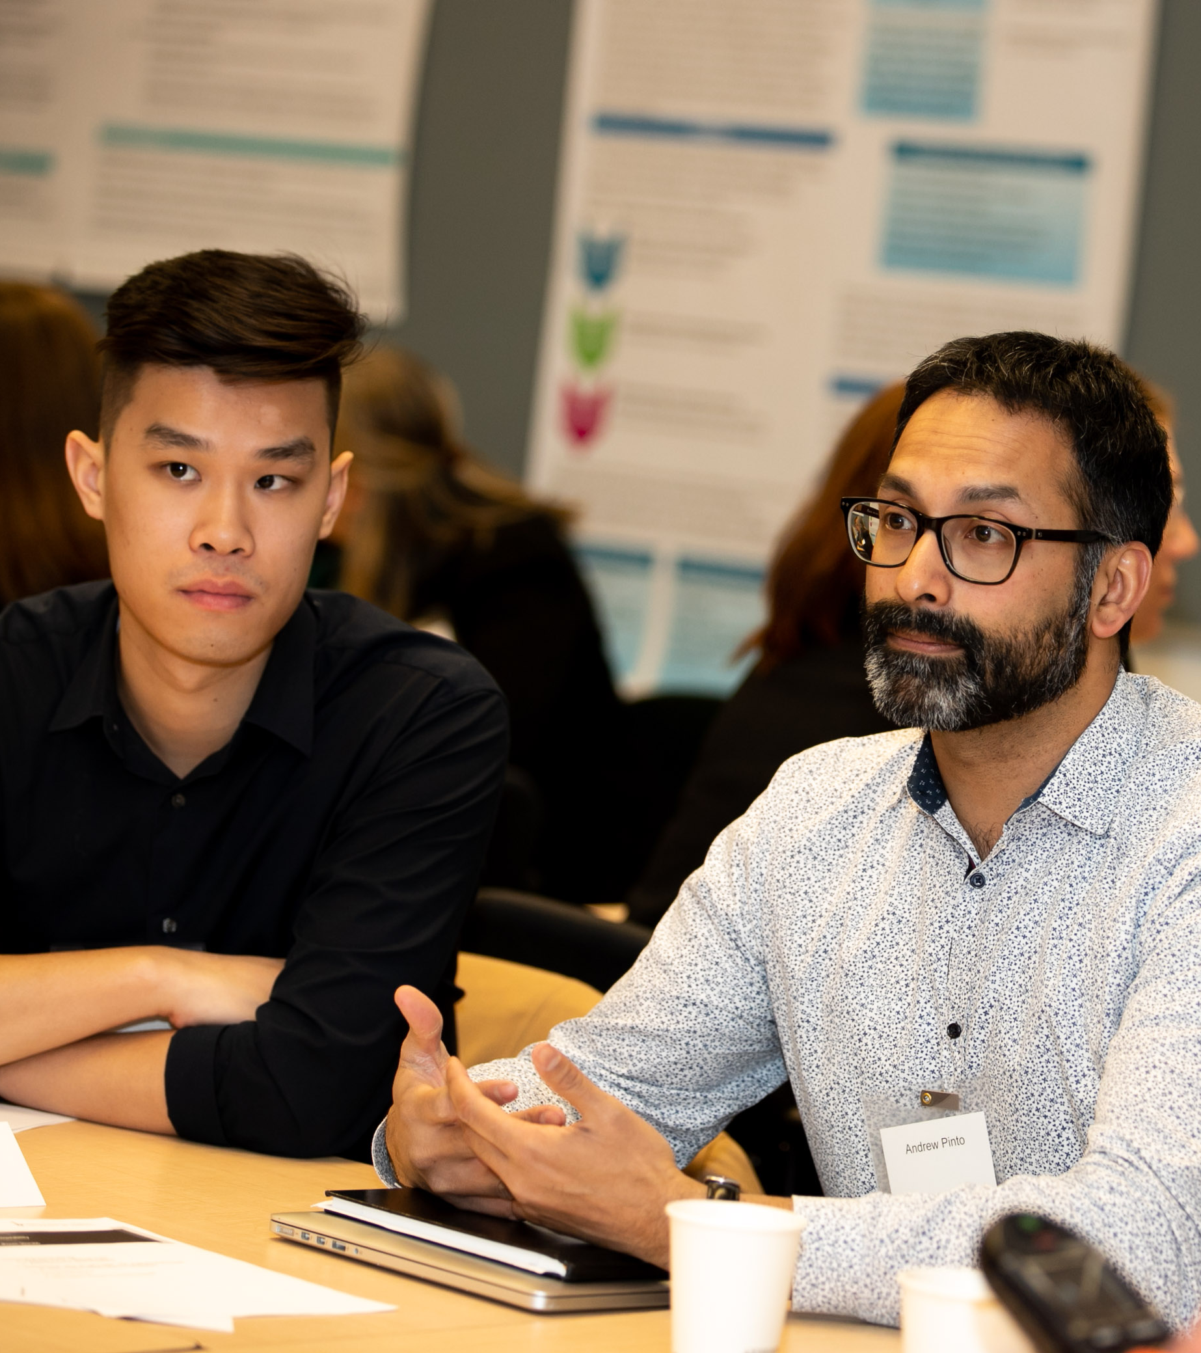
To help you understand what a junior promotion is
To help you look at the work you’re engaged in and how it applies to the criteria
To review the documents and help you assemble a successful dossier
GOALS OF THE WORKSHOP

Slide 4
WHAT IS A JUNIOR PROMOTION?
In the Faculty of Medicine, a JUNIOR PROMOTION
refers to promotion to the academic rank of Assistant Professor (for clinical MD faculty).
Successful candidates for promotion will be expected to demonstrate sustained contributions to the academic mission.
Candidates must show evidence of academic impact, importance, and innovation, and to show themselves to be an effective teacher.

Slide 5
This is the University’s way of recognizing your outstanding accomplishments
To deepen your understanding of your own academic work and career
To become a leader in your field
To take on leadership roles in the DFCM
To further the discipline of family medicine
WHY APPLY FOR A JUNIOR PROMOTION?

Slide 6
WHAT IS DAC?
The DAC is our Department Appointments Committee. It has the principal job of reviewing new appointments as well as dossiers from candidates recommended for junior promotion to the rank of Assistant Professor.
DAC acts as an advisor to our DFCM Department Chair. Once DAC supports the application, it is sent to HR for the Dean’s Approval.
The DAC meets on a monthly basis from September – June.
Junior promotions may be submitted and reviewed at any point during that time.

Slide 7
CRITERIA FOR PROMOTION
Candidates must go forward on one of the following:
To create a stunning presentation, it's best to simplify your thoughts.
SUSTAINED COMMITMENT
ADVANCED DEGREE
Notes:
More icons can be found on PowerPoint at Insert > Icons

Slide 8
CRITERIA #1: SUSTAINED COMMITMENT
- A continuous and long-standing commitment
- Demonstrated evidence of academic impact/leadership/scholarship within the DFCM
- A dedication and responsibility to your discipline
To create a stunning presentation, it's best to simplify your thoughts.
There is no “set” timeline of eligibility, but generally the Faculty expects:
Full time faculty (>80%) – at least 3 years of appointment
Part time faculty (20-80%) – at least 3-5 years of appointment
Adjunct faculty (<20%) – closer to 7-10 years of appointment
Keep in mind: this varies for each individual based on their time commitment, academic productivity, and competing responsibilities
Notes:
More icons can be found on PowerPoint at Insert > Icons

Slide 9
SUSTAINED COMMITMENT CATEGORIES
Candidates going forward for promotion on the basis of sustained commitment must choose 1 (or more) category:
TEACHING EFFECTIVENESS
EDUCATIONAL OR CURRICULUM DEVELOPMENT
CREATIVE PROFESSIONAL ACTIVITY (CPA)
RESEARCH
Faculty may go forward under one or more categories
To create a stunning presentation, it's best to simplify your thoughts.
Notes:
More icons can be found on PowerPoint at Insert > Icons

Slide 10
EXAMPLES
TEACHING EFFECTIVENESS
Clinical teaching
Lectures, seminars
EDUCATION OR CURRICULUM DEVELOPMENT
Planning a new curriculum or education production
Educational innovation or new educational materials
CPA
RESEARCH
Small groups - supervision
Education scholarship
Contributions to the development of professional practices, e.g., guidelines, health policy development, regulatory committees and setting standards
Exemplary professional practice, e.g., teaching techniques, educational innovations, curriculum development, models of care innovations
Professional innovation and creative excellence, e.g., patient videos, curriculum innovations, and communications media
Productivity in research/research-related activities
Publications
Demonstrating that research has led to a significant source of new information in the field
QI-related
To create a stunning presentation, it's best to simplify your thoughts.
Notes:
More icons can be found on PowerPoint at Insert > Icons

Slide 11
CRITERIA #2: ADVANCED DEGREE
Faculty may apply for a junior promotion based on advanced degree AT ANY TIME once they meet both the following criteria:
To create a stunning presentation, it's best to simplify your thoughts.
A) MASTER’S DEGREE
Completion of a post-MD master’s degree (since time of appointment) in a related healthcare field
B) PUBLICATIONS
AT LEAST 1-2 first author peer-reviewed publications in well-regarded journals
Notes:
More icons can be found on PowerPoint at Insert > Icons

Slide 12
TEACHING DOSSIER
What is a teaching dossier?
All junior promotions must include a teaching dossier. It is a portfolio of documents that paint a picture of your strengths and accomplishments as a teacher
Forms a major part of the application for a junior promotion
The DFCM has provided a suggested template that is recommended by the Faculty of Medicine
This format is an effective tool for showcasing individual approaches to teaching
Please visit the DFCM website to download it: http://www.dfcm.utoronto.ca/junior-promotion
Tips:
Start early and save everything
Course materials, evaluations, student comments, evidence of teaching effectiveness
Develop a teaching philosophy
1-2 page narrative: what is your identity and how have you developed as a teacher?
Take advantage of professional development opportunities and document them

Slide 13
SUPPORTING DOCUMENTATION
Supporting documentation is *OPTIONAL* and may be included
in your dossier as evidence of impact.
Please curate well. Pick and choose only the best of the best!
Examples:
Publications (required for research dossiers), presentations (multiple slides per page), thank you letters, colleague letters, media coverage

Slide 14
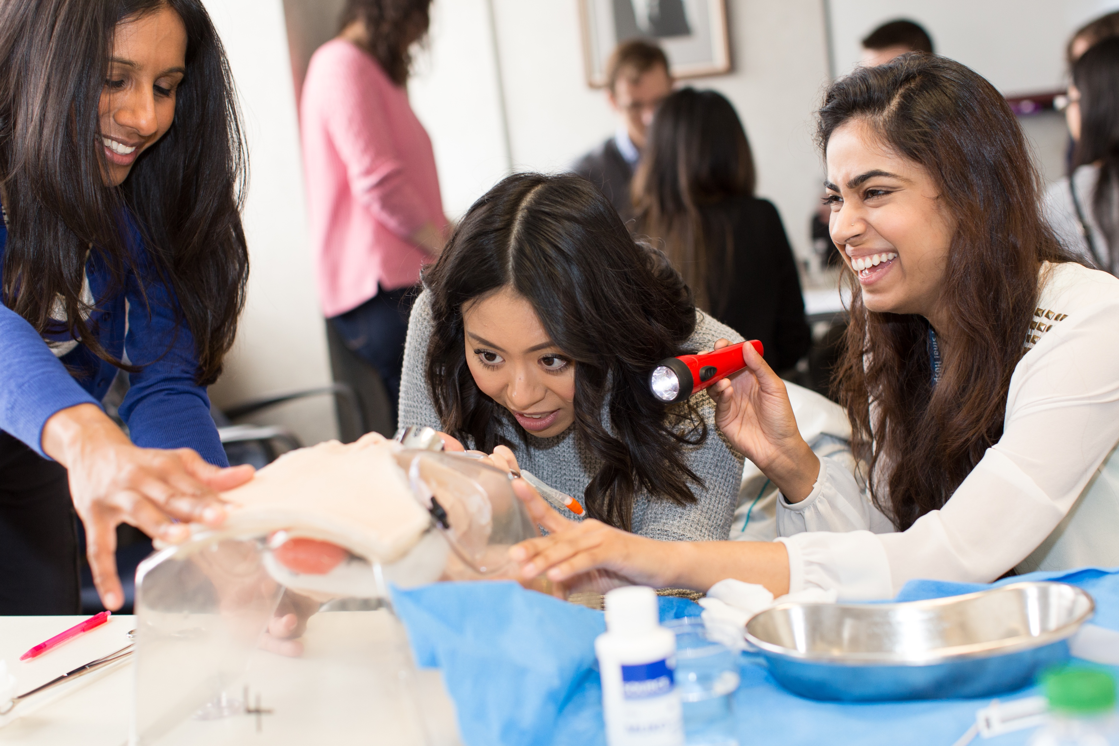
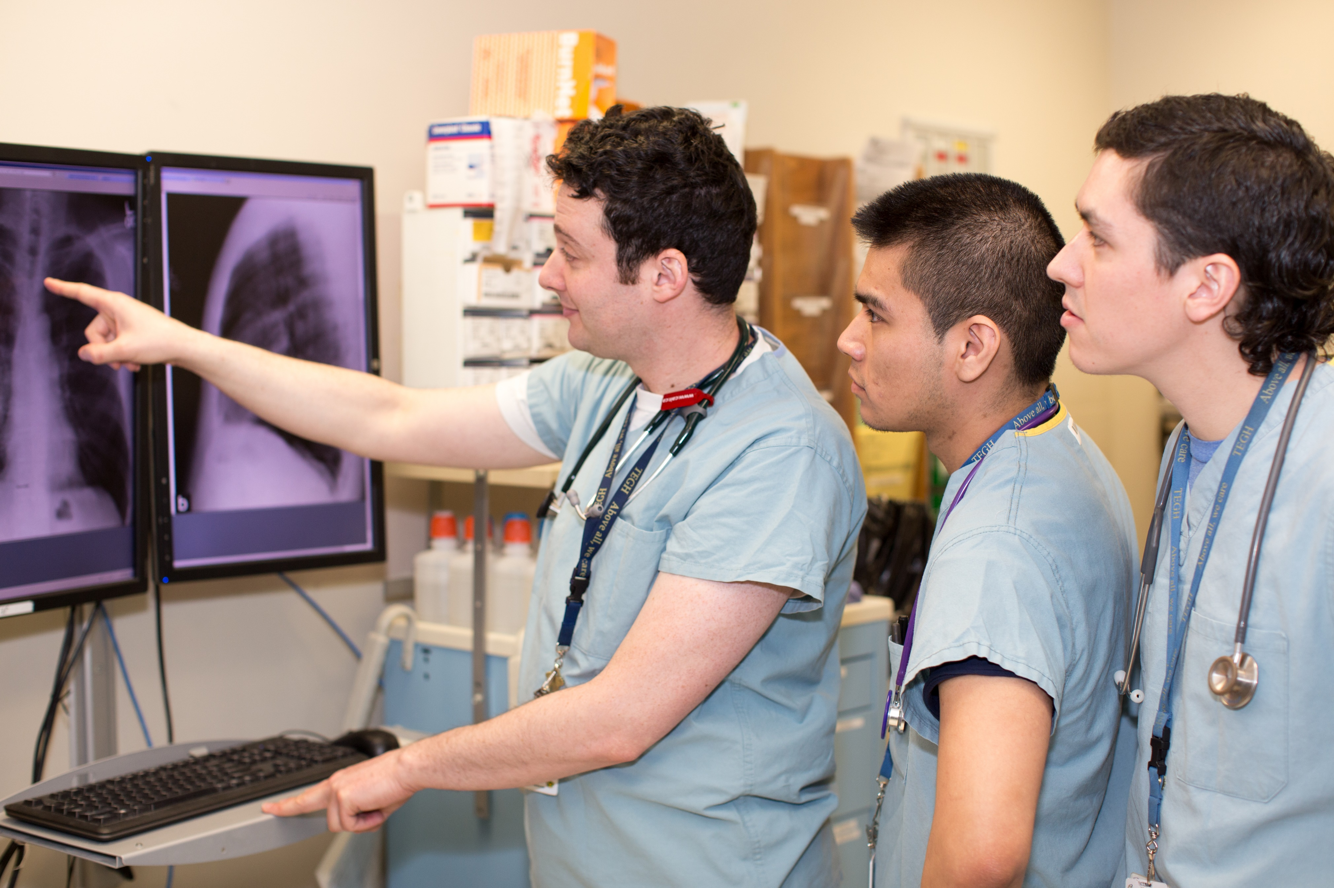
STEPS & PROCESS
Notes:
Sarah – to present administrative steps/process

Slide 15
STEPS IN THE JUNIOR PROMOTION PROCESS
PRE-APPLICATION
APPLICATION
APPROVAL
Your Site/Program Administrator will:
Solicit internal reference letters
Collect your documents and a support letter from your Chief
Submit the application to the DFCM via online application form
Dossier is reviewed and supported by DAC
Application is submitted to HR
Full time promotions are reviewed by FAAC (monthly)
Once approved by the Dean, the DFCM is notified by HR
We send a congratulations letter via email
Meet with your Chief and/or FD Lead
Meet/communicate with your site administrator
Prepare your documents (i.e. CV and Teaching Dossier)
Collect documentation
Promoted faculty are invited to an annual DFCM recognition event in the summer
Notes:
Sarah

Slide 16
WHAT DOCUMENTS ARE REQUIRED?
 | DOCUMENT | RESPONSIBLE PARTY
1 | Online application form (at time of submission) | Hospital admin
2 | Chief’s letter of support | Chief
3 | CV | Faculty
4 | Academic position description | Faculty + Chief
5 | Time commitment form (only for full time) | Faculty + Chief
6 | 2-3 internal reference letters | Hospital admin
7 | Teaching philosophy statement | Faculty
8 | Teaching dossier | Faculty
9 | Teaching data summary table | Faculty
10 | Teaching evaluations | Faculty + hospital admin
11 | Supporting documentation/pubs (if applic.) | Faculty
12 | Professional development plan | Faculty + FD lead
13 | Profile form | Faculty or hospital admin
CHECKLIST GUIDE
On our website: https://www.dfcm.utoronto.ca/
junior-promotion
Provides detailed information on required documents
Identifies who is responsible for each document (Chief/Faculty/Administrator)
Tips for your dossier
Plus, if applicable:
14 | Research statement & dossier OR CPA statement & dossier | Faculty
Notes:
Sarah

Slide 17
DISCUSSION POINTS WITH YOUR CHIEF OR
FD LEAD
Determine that you meet the CRITERIA
Review the required docs and who will be completing what in the application
Choose internal referees
What aspects of your academic work you’re most proud of
What “products” best illustrate your work?
DISCUSSION POINTS WITH YOUR SITE OR PROGRAM ADMINISTRATOR
Review the online application form
Identify who is completing what in the application
Set a target date for completion
Soliciting internal reference letters
Submitting the final application to the DFCM
Viewing sample copies of successful applications
To create a stunning presentation, it's best to simplify your thoughts.
Notes:
Sarah

Slide 18
JUNIOR PROMOTION VS. CAR
A junior promotion and a CAR (continuing appointment review) are two separate processes.
It is NOT POSSIBLE to combine them.
A CAR is a probationary review ONLY for full time faculty. It should occur after their 3rd year and before their 5th year of appointment. Once approved, their appointment transfers to “continuing”. This review is designed as a “check in” to ensure that the faculty member has met the terms and conditions of their appointment to the Department.
The application is much shorter than a junior promotion.
The CAR occurs on a yearly cycle and is due in the spring.
Eligible faculty this year have already been contacted.
More info: https://www.dfcm.utoronto.ca/continuing-appointment-review-car
To create a stunning presentation, it's best to simplify your thoughts.
Notes:
Sarah

Slide 19
TAKE HOME MESSAGE
Meet with:
Your Chief
Your FD Lead
Think about working with a peer or mentor to work on your dossier and set goals
Get started:
Update your CV
Update your Teaching Dossier
Visit our website for templates & forms
Collect your TES
Organize your work and start an electronic filing system for yourself

Slide 20
VIDEO SERIES
The DFCM is pleased to provide FOUR VIDEOS interviewing
DFCM faculty on junior promotions:
TOPICS:
Junior Promotion – what has this meant to you?
Junior Promotion – who has helped you?
Junior Promotion – do you have any advice for others?
How to make junior promotions easer
Please watch via our website: https://www.dfcm.utoronto.ca/junior-promotion

Slide 21
Thank you!
Questions?
Contact: Sarah Letovsky, DFCM Academic Promotions Coordinator
dfcm.promotion@utoronto.ca
Notes:
Q&A

