Slide 1
HOW DO I BECOME AN ASSOCIATE OR FULL PROFESSOR?
Senior Promotion Workshop #1 • February 26, 2021
Facilitated by:
Dr. Viola Antao, DFCM Faculty Development Director
Sarah Letovsky, DFCM Academic Promotions Coordinator
Introduction by Dr. David White, Department Promotions Committee Chair
Notes:
Welcome

Slide 2
Promotion Pitfalls
Senior Promotion Workshop 1
February 26, 2021
David White
Chair, Senior Promotion Committee
Notes:
Dr. White

Slide 3
Top 3 Promotion Pitfalls for family doctors
Not applying
Family doctors are modest and self-effacing
Not applying
We do a lot…but are too busy to keep track
Not applying
It’s important…but not urgent
Notes:
Dr. White

Slide 4
All the Other Common Pitfalls
CV not in the proper format
Use the template
CV inaccurate
Enter correctly starting NOW (check old entries)
Not meeting the criteria
Read the “Manual for Academic Promotion”
Notes:
Dr. White

Slide 5
Pitfalls that lurk
Crisis at work
Avoid pandemics & similar
Personal Crisis
Defer promotion
No help, no support
Use resources. Reach out. “It takes a village.”
Notes:
Dr. White

Slide 6
You.
Can.
Do.
It!
Notes:
Dr. White

Slide 7
Thank you!
Questions?
Notes:
Dr. White

Slide 8
OVERVIEW
What is a senior promotion?
Identifying the criteria, steps, timeline and process
GOALS OF THE WORKSHOP
Sarah Letovsky
COMPONENTS
Overview and components of the (1) pre-application and (2) promotion dossier
GETTING STARTED
Helping you begin to organize your academic work
Take home message and early do’s and don’ts
Notes:
Sarah

Slide 9
WORKSHOP OVERVIEW
Accessible Help
WORKSHOP 1
WORKSHOP 2
WORKSHOP 3
To create a stunning presentation, it's best to simplify your thoughts.
Criteria, steps, timeline & process
Overview and components of (1) pre-application and (2) promotion dossier
Next steps and take home message
March 26, 2021
Guest faculty advisors for group discussion
Review of pre-application
Overview of scholarly activity in research, CPA, teaching & education
Assist faculty with identifying 5 scholarly pieces of work
May 28, 2021
Dedicated only to candidates that have been “supported” to go forward
Letter of application
Reflective statement
Identifying external reviewers
Final components of senior promotion dossier
Notes:
Sarah

Slide 10
Senior promotion refers to promotion
to the academic ranks of
Associate Professor and
full Professor
Academic promotion in the Faculty of Medicine recognizes the notable achievements of faculty members in their discipline and contributions to the University of Toronto.
WHAT IS A SENIOR PROMOTION?
Dr. Viola Antao
Notes:
Dr. Antao

Slide 11
What is a Senior Promotion?
Promotion is not granted as a reward for long-term service, but rather to recognize those who have EXCELLED in specific aspects of the academic mission.
The successful candidate for promotion will be expected to have established a wide reputation in his or her field of interest, to be deeply engaged in scholarly work, and to show him or herself to be an effective teacher.
Notes:
Dr. Antao

Slide 12
The successful candidate for promotion will be expected to have established a wide reputation in his or her field of interest, to be deeply engaged in scholarly work, and to show themselves to be an effective teacher.
WIDE REPUTATION
Associate Professor = National
Professor = International
This is demonstrated through accomplishments in Research, Creative Professional Activity (CPA), and Teaching & Education.
ALL candidates must demonstrate teaching/education activity. This is a mandatory component in a promotion dossier.
CRITERIA FOR A SENIOR PROMOTION
Notes:
Dr. Antao

Slide 13
READINESS FOR PROMOTION
Successful promotion is not based on longevity – it is based on merit.
However, it is expected that senior promotion candidates are eligible around 5 years or later since the date of their last promotion.
Usually, a request for promotion prior to 5 years since the last promotion is considered an “accelerated promotion” by the Decanal Committee and the dossier should clearly explain why there is a request for accelerated promotion.
Your Site Chief/Division Head/Program Director AND Dr. White should help you determine your readiness for promotion.
Notes:
Dr. Antao

Slide 14
CRITERIA
You need to demonstrate “excellence” in at least ONE area and “competence” in the other areas:
Research
Creative Professional Activity (CPA)
Teaching & Education
Administrative Service (cannot declare excellence)
You must also provide 5 significant scholarly pieces of work.
The definition of “scholarly work” can be broad. Some examples:
Publications, Curriculum design, CPA work, QI, government docs, website development, etc
TIME DEDICATED TO THIS IN WORKSHOP #2
Notes:
Dr. Antao

Slide 15
Research
CRITERIA:
Record of sustained and current productivity in research and research-related activities.
Research advances will be communicated through the publication of papers, reviews, books and other scholarly works.
The quality of the scholarship in research will be judged in comparison to peers in the Faculty of Medicine and to others in the same field in peer institutions.
Research Funding:
If seeking promotion on the basis of excellence in research, the candidate should have a strong and continuing record of external funding commensurate with the type and area of research
Publications:
There must be a sustained record of scientific publications demonstrating that the research has lead to a significant source of new information in the field
TIME DEDICATED TO THIS IN WORKSHOP #2
Notes:
Dr. Antao

Slide 16
CREATIVE PROFESSIONAL ACTIVITY (CPA)
CRITERIA:
The Faculty of Medicine recognizes CPA under the following three broad categories:
Professional Innovation and Creative Excellence
To demonstrate professional innovation, the candidate must show an instrumental role in the development, introduction and dissemination of an invention, a new technique, a conceptual innovation or an education program
Contributions to the Development of Professional Practice
Must demonstrate leadership in professional organizations, government or regulatory agencies that has influenced standards and/or enhanced the effectiveness of the discipline (e.g. guideline development, health policy development)
Exemplary Professional Practice
Must show that his or her practice is recognized as exemplary by peers and has been emulated or otherwise had an impact on practice
TIME DEDICATED TO THIS IN WORKSHOP #2
Notes:
Dr. Antao

Slide 17
EXAMPLES OF CPA
QI
Dissemination of educational innovations
Development of health policies
Evidence of leadership that has influenced standards
Creation of media, e.g., websites
Roles in professional organizations
Scholarly publications, books, chapters
Non peer-reviewed and lay publications
Invitations .. meetings, workshops, talks, interviews
Presentations of regulatory bodies, governments, etc.
Knowledge transfer
TIME DEDICATED TO THIS IN WORKSHOP #2
Notes:
Dr. Antao

Slide 18
Teaching & Education
Candidates seeking promotion on the basis of excellence in teaching and education must demonstrate significant and high quality contributions to teaching and/or other education related activities in at least one of the following:
Sustained excellence in teaching
Participation in education and curriculum development
Contribution to the field of health professional education
Education leadership in faculty, department, division or hospital
➲ External Waiver (next slide)
TIME DEDICATED TO THIS IN WORKSHOP #2
Notes:
Dr. Antao

Slide 19
WAIVER OF EXTERNAL REVIEW
Will you have sustained “excellence” in
teaching & education ONLY?
A Waiver of External Review recognizes the fact that some faculty spend a large portion of their time in clinical work and teaching rather than scholarship (research/CPA) and therefore are NOT necessarily known nationally or internationally.
In this case, INTERNAL referee letters (not EXTERNAL) are solicited.
This Waiver should not be used for a candidate where research/CPA is an important part of the evaluation.
IMPORTANT: this must be identified early in the process - at the time of your meeting with Dr. White & in your pre-application.
Candidates seeking promotion on the basis of EXCELLENCE in teaching would be expected to show evidence in three or more
of these attributes:
Lecturing to large group
Facilitation of small groups
One-to-one teaching
Supervision
Mentoring
PLUS
Mastery of the subject area
Reference:
Manual for Academic Promotion
Notes:
Dr. Antao

Slide 20
Administrative Service
Administrative service in itself cannot be the main criteria for promotion.
Significant service contributions may include (but not limited to):
Service to the Department, Faculty of Medicine, University: committee chair, lead coordinator of a special project, lead developer of faculty policies
Service to the professional, clinical or research discipline
Service to municipal, provincial or federal governments or non-government agencies
TIME DEDICATED TO THIS IN WORKSHOP #2
Notes:
Dr. Antao

Slide 21
5 Scholarly Works/Publications
Can include a wide variety of “work”:
Publications - peer reviewed journals
Book/book chapter
Government documents, reports
Curriculum design document
“Learning object” – e.g.. a teaching video
Websites (provide active URL)
TIME DEDICATED TO THIS IN WORKSHOP #2
Notes:
Dr. Antao

Slide 22
QUESTIONS SO FAR?
Notes:
BRIEF Q&A

Slide 23
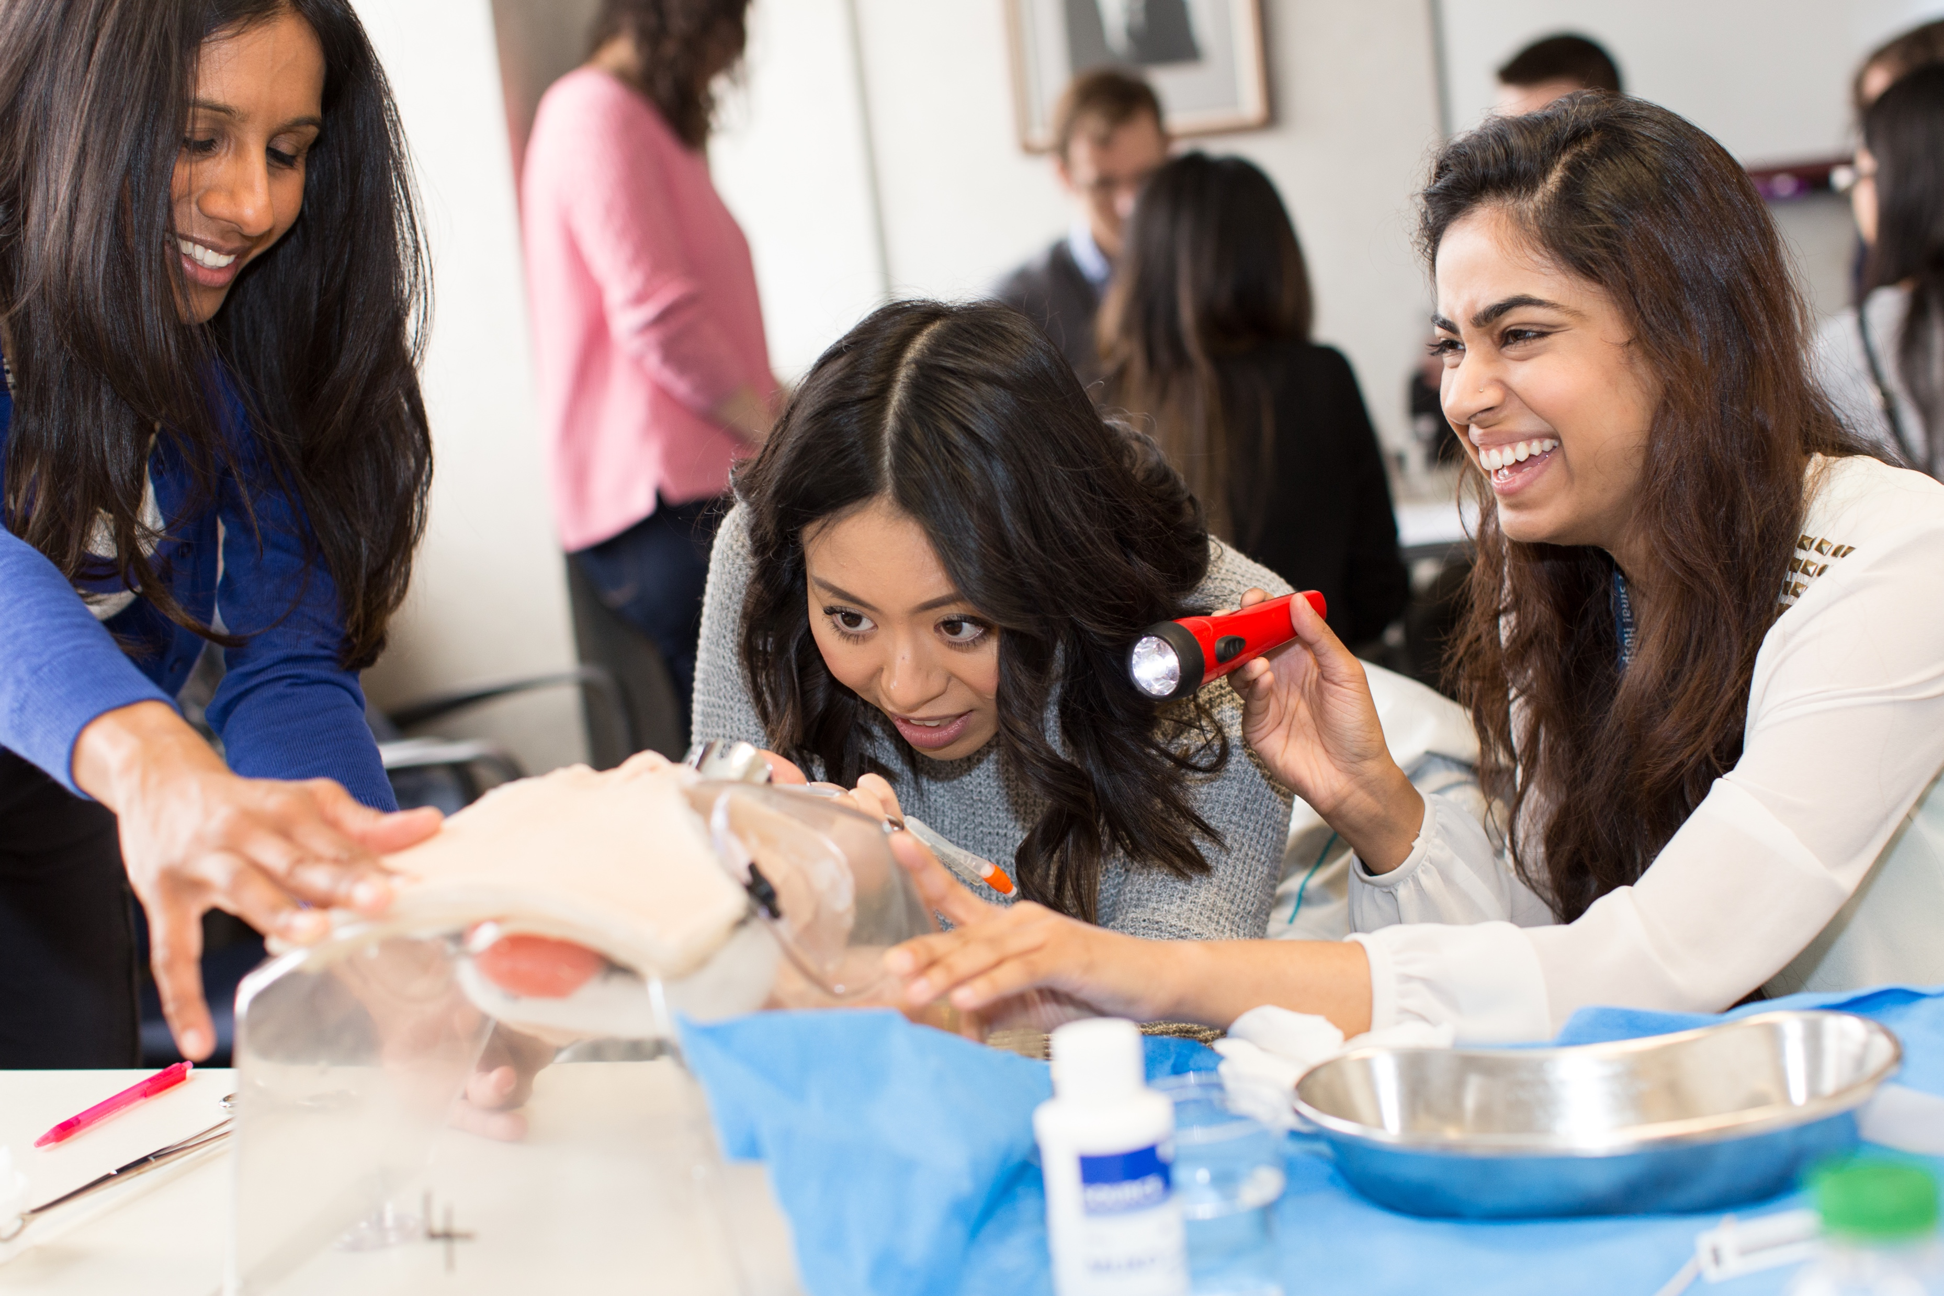
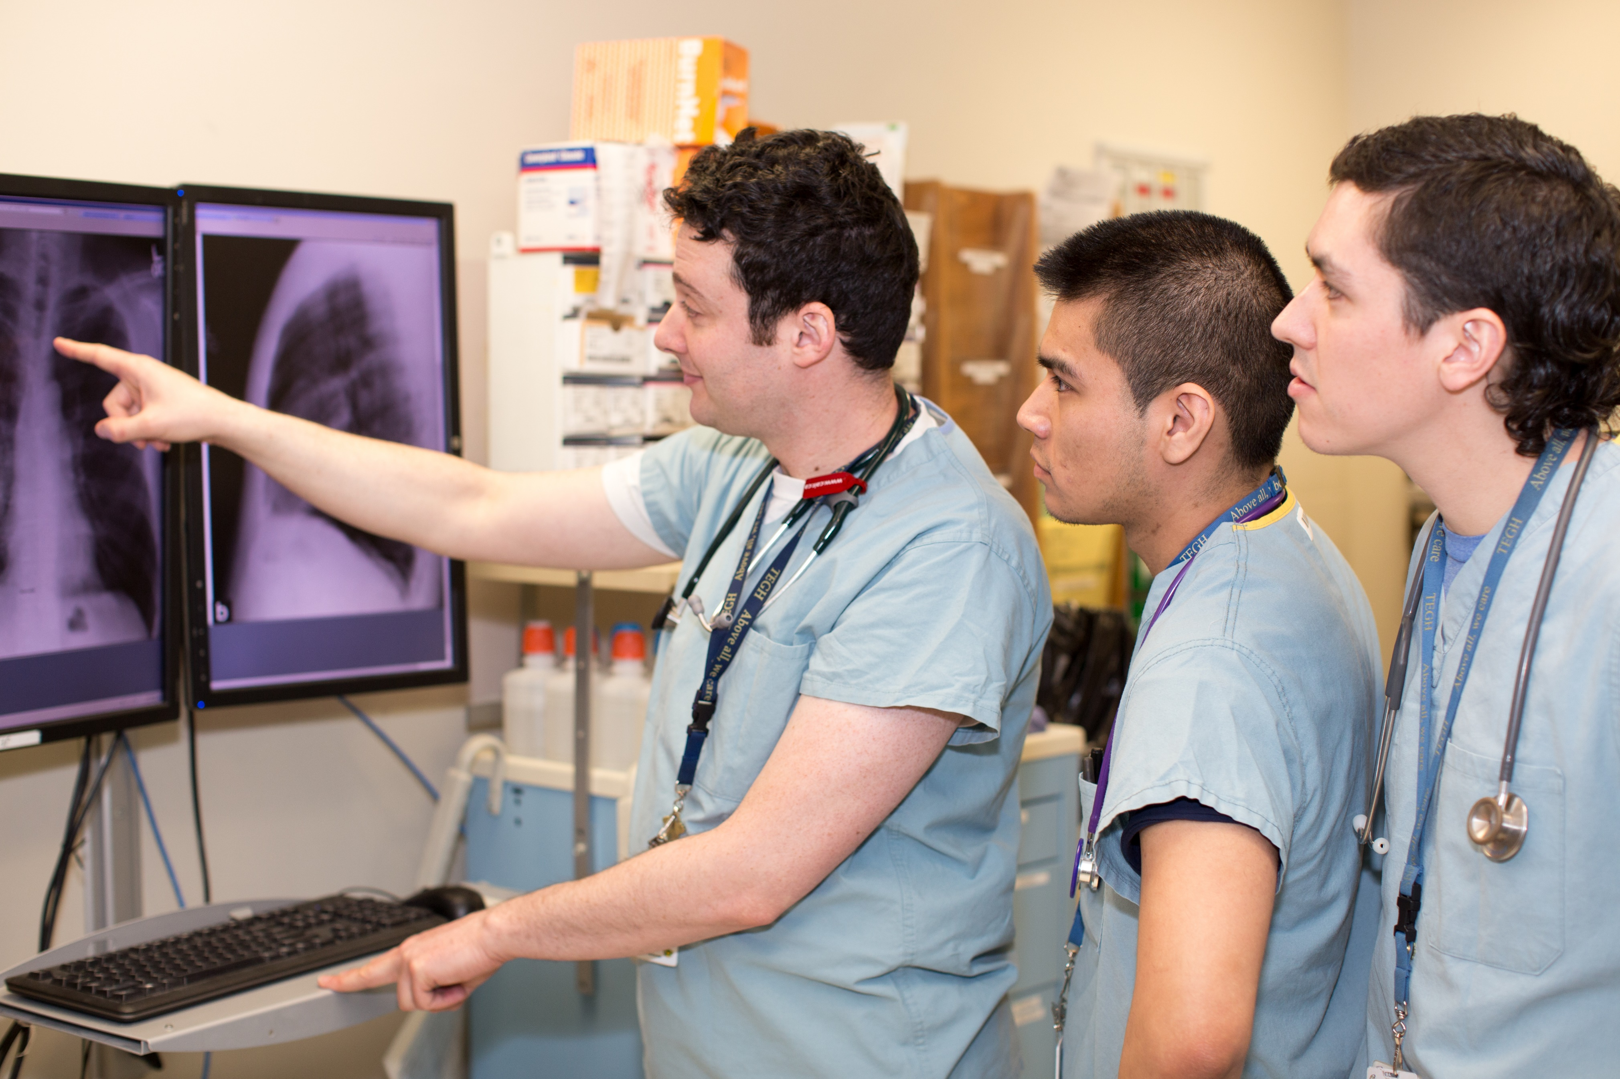
TIMELINE & PROCESS
Sarah Letovsky
Notes:
Sarah – Timeline and Process

Slide 24
NEXT STEPS IN THE PROCESS
Important dates for 2021-2022
Meet with your respective DFCM Site Chief, Division Head, or Program Director
by March 26, 2021
Meet with Dr. White
by March 26, 2021
Attend workshop #2
on Mach 26, 2021
Submit a pre-application
by April 30, 2021
Place a calendar “hold” for workshop #3
on May 28, 2021
Work on your full dossier for submission
Due the week of Sept 6-10th
SENIOR PROMOTION TIMELINE
Download the full 2021-2022 timeline on our website:
https://www.dfcm.utoronto.ca/senior-promotion
Notes:
Sarah

Slide 25
PRE-APPLICATION
DUE DATE
APRIL 30, 2021
REQUIRED DOCUMENTS FOR
A PRE-APPLICATION:
Application Form
Identified areas of excellence & competence
Identified scholarly pieces of work (5)
Curriculum Vitae
Teaching Dossier
Teaching data summary report
You can download the pre-application on our website: https://www.dfcm.utoronto.ca/senior-promotion
We will be reviewing the pre-application TOGETHER in workshop #2
Sample pre-applications can be provided by request (dfcm.promotion@utoronto.ca)
CONFIDENTIAL: Do not share/distribute
Notes:
Sarah

Slide 26
PROMOTION DOSSIER
DUE DATE:
THE WEEK OF
SEPT 6 – 10, 2021
THE PROMOTION DOSSIER IS DIVIDED INTO THE FOLLOWING FOLDERS:
Reporting Letters
Teaching & Education
CV and Scholarly Works
Administrative Service
PLUS
CPA
AND/OR
Research
Set documents are required for each section where excellence/competence is declared.
We will review all the important components of the full dossier in Workshops #2 and #3.
You will receive FEEDBACK on your pre-application from the DFCM Senior Promotions Committee
This will allow you to take your pre-application and build it into a full dossier
Important components of the dossier will be reviewed at Workshop #3
A database of sample dossiers will be provided to you
Notes:
Sarah

Slide 27
NEXT STEPS
Notes:
Dr. Antao

Slide 28
EARLY DO’S & DON’TS:
DO:
Meet with your Chief/Division Head (if you haven’t already)
Once you’ve done that, meet with Dr. White (if you haven’t already)
Secure administrative assistance (on site or privately)
Read the promotions manual (very important)
DO NOT:
Solicit a letter of support from your Chief (we will do this)
Ask friends or colleagues to serve as an internal or external referee – we will cover this topic in Workshop #3
Approach referees directly (we will do this)
Throw away or delete anything!
Leave your pre-application to the last minute – this can be a time consuming task
Notes:
Dr. Antao

Slide 29
TAKE HOME MESSAGE
Get started early:
Update your CV – use the DFCM format (available on our website) and make sure it’s clear, error-free and up-to-date
Update your Teaching Dossier
Book dedicated time in your schedule
Collect your TES → data summary table
Start collecting evidence (i.e. evaluations, letters from colleagues, emails, etc)
Organize your work and start an electronic filing system for yourself
Don’t get overwhelmed – we will help you through the process
Notes:
Dr. Antao

Slide 30
WORKSHOP #2 – March 26, 2021
HAVE YOUR CV WITH YOU
DOWNLOAD AND REVIEW THE PRE-APPLICATION TEMPLATE
This workshop will provide a more detailed look at identifying excellence or competence in each of four areas (research, CPA, teaching and education, administrative service) as well as identifying your five scholarly pieces of work
Time will be dedicated to talking with “faculty advisors” in the area of Research, Teaching & Education, or CPA
We will review the Senior Promotion Pre-Application in detail
Notes:
Dr. Antao

Slide 31
VIDEO SERIES
In addition to our workshops, we are also pleased to provide three videos of DFCM faculty addressing questions and providing advice on the process of becoming an Associate Professor or full Professor.
TOPICS:
What has a senior promotion meant to you?
Do you have any advice for others in preparing for a senior promotion?
Who has assisted you in the senior promotion process?
Please watch via our website: https://www.dfcm.utoronto.ca/senior-promotion
Notes:
Sarah

Slide 32
Thank you!
Questions?
Contact:
Sarah Letovsky, DFCM Academic Promotions Coordinator
Dfcm.promotion@utoronto.ca
Notes:
Q&A session

