Slide 1
SENIOR PROMOTION WORKSHOP #2
March 26, 2021
Facilitated by:
Dr. Viola Antao, DFCM Faculty Development Director
Sarah Letovsky, DFCM Academic Promotions Coordinator
Joining us:
Dr. David White, DFCM Promotions Committee Chair
Guest faculty advisors (3:30pm)
Notes:
Dr. Antao - Welcome

Slide 2
MAPPING THE FOUNDATION OF THE PRE-APPLICATION
IDENTIFY ACCOMPLISHMENTS OF SCHOLARSHIP
WELCOMING GUEST FACULTY ADVISORS (3:30PM)
Dr. Rahim Moineddin - Research
Dr. Allan Grill - CPA
Dr. George Porfiris - Teaching & Ed
GOALS OF THE WORKSHOP
Notes:
Sarah

Slide 3
A NOTE ON CONFIDENTIALITY…
All conversations, promotion material, and sample dossiers/pre-applications are considered highly confidential.
This is to protect our faculty, their work, and the integrity of the process.
Notes:
Sarah

Slide 4
BY NOW YOU WILL HAVE…
Reviewed the Manual for Academic Promotion
Taken a look at the pre-application template
Met with your respective Chief/Division Director
This meeting is mandatory: to ensure your Chief is in support
Confirmation required in the pre-application
Met with Dr. David White, DPC Chair
This meeting is mandatory: to discuss readiness for promotion
Confirmation required in the pre-application
Notes:
Sarah

Slide 5
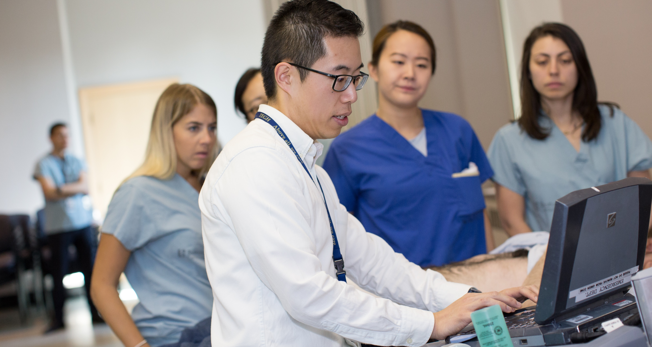
PRE-APPLICATION
Notes:
Sarah

Slide 6
To give you a strong framework and starting point to build out your full dossier
For the Department Promotions Committee (DPC) to make a recommendation
Feedback on your promotion platform/scholarly works
Increase your chance of success
Matching you with a mentor
PURPOSE OF THE PRE-APPLICATION
Notes:
Sarah

Slide 7
PRE-APPLICATION PROCESS
Pre-Applications are due on April 30, 2021
Once submitted, they are reviewed by assigned members of our promotions committee
Each member presents their recommendation to the committee for discussion (support to go forward or defer)
A letter is sent to the candidate with feedback and a recommendation
Candidates approved to go forward based on their pre-application are invited to workshop #3 (May 28, 2021)
Each candidate supported to go forward is assigned a faculty advisor/mentor
Final dossier due: week of September 6 - 10
Notes:
Sarah

Slide 8
PRE-APPLICATION OVERVIEW
The following documents are required:
Application form
Identified areas of excellence or competence (3)
Identified scholarly pieces of work (5)
CV
Teaching Dossier
Teaching data summary report
Sample Pre-Applications AND dossiers can be provided by request: dfcm.promotion@utoronto.ca
! CONFIDENTIAL: Do not share/distribute !
Where do I find
the pre-application template?
Download the 2021-22 template
on our website:
https://www.dfcm.utoronto.ca/senior-promotion
Notes:
Sarah

Slide 9
DR. DAVID WHITE
IMPORTANCE OF:
FACULTY OF MEDICINE CV TEMPLATE
MANUAL FOR ACADEMIC PROMOTION
Both can be found on our website: https://www.dfcm.utoronto.ca/senior-promotion
Notes:
Dr. White

Slide 10
PAUSE FOR ANY QUESTIONS
IN ZOOM CHAT
Notes:
Pause to review any questions in zoom chat

Slide 11
EXCELLENCE/COMPETENCE
You must claim EXCELLENCE in (at least) 1 category:
To create a stunning presentation, it's best to simplify your thoughts.
RESEARCH
CPA
TEACHING &
EDUCATION
ADMIN SERVICE
Notes:
Dr. Antao

Slide 12
RESEARCH
Promotion to Associate or full Professor based on research requires that the candidate has a record of
sustained and current productivity in research and research-related activities.
Research funding:
Strong and continuing record of external funding commensurate with the type and area of research
Publications:
Sustained record of scientific publications demonstrating a significant source of new information in the field (articles in major peer-reviewed journals, books, book chapters, and published abstracts)
Scientific Presentations:
Presentations at national/international meetings recognized as significant academic venues are considered
Invited presentations and named lectureships are an indicator of the candidate’s reputation outside the university
Participation, Leadership & Mentorship in the research community:
Include a range of activities: organization of meetings or symposia, leadership in committees, development or promotion of research infrastructure, grant panels, etc…
Assessments will be performed on the basis of the originality and importance of the research, its impact on the discipline, and a judgement of the candidate’s stature in the field relative to their peers locally, nationally and/or internationally.
PROMOTIONS MANUAL - PG 14
Notes:
Dr. Antao

Slide 13
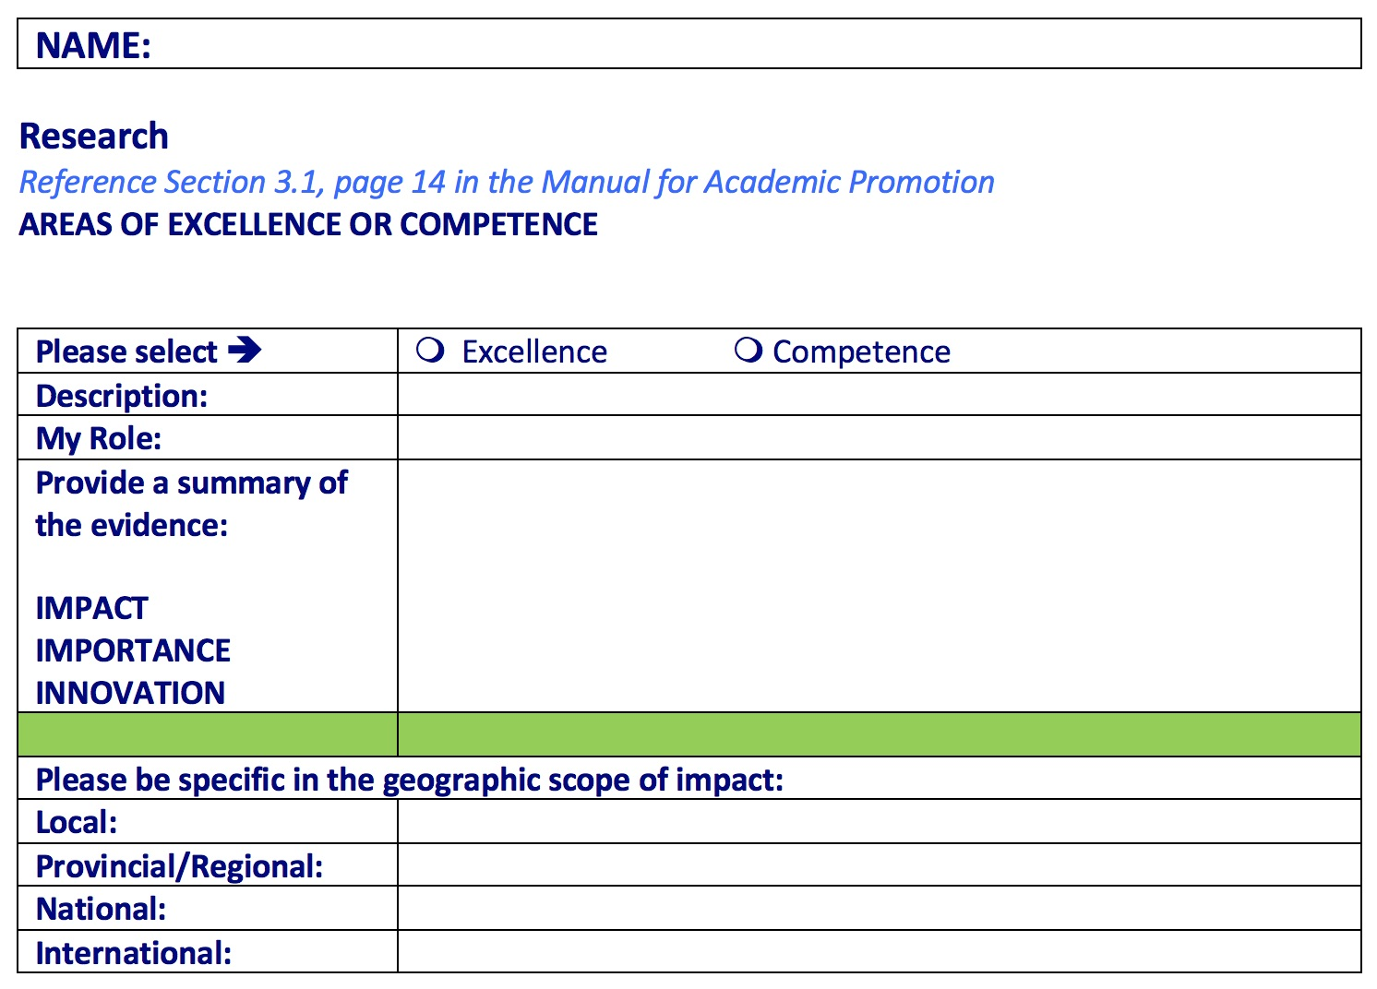
RESEARCH – PRE-APPLICATION
Provide a summary of the originality and importance of the research and it’s impact
Notes:
Dr. Antao

Slide 14
CREATIVE PROFESSIONAL ACTIVITY (CPA)
The Faculty of Medicine acknowledges CPA under the following three broad categories:
Professional Innovation and Creative Excellence
Must show an instrumental role in the development, introduction and dissemination of a new invention, technique, conceptual innovation, a QI or an educational program.
Contributions to the Development of Professional Practice
Must demonstrate leadership in the profession, professional organizations, government or regulatory agencies that has influenced standards and/or enhanced the effectiveness of the discipline
Exemplary Professional Practice
Must show that his/her practice is recognized as exemplary by peers and has been emulated or otherwise had an impact on practice
There may be diverse and sometimes innovative markers used to indicate the impact of CPA:
Scholarly or lay publications, Guidelines, development of health policies, presentations to regulatory bodies, evidence of dissemination of educational innovation, creation of media (e.g. website), social media analytics, etc
PROMOTIONS MANUAL - PG 20
CPA GUIDE – PG 73
Notes:
Dr. Antao

Slide 15
SUB-CATEGORY OF CPA: QI
Quality Improvement (QI) is a recognized subcategory of CPA.
QI can be challenging due to the complex nature of healthcare in Canada. The CPA for a candidate focused on QI work may weave together evidence of impact beyond traditional metrics such as publications and grants – including some committee work, invited presentations, and documentation attesting to interest in the emulation of the candidate’s QI work at other institutions.
Notes:
Dr. Antao

Slide 16
SUB-CATEGORY OF CPA: QI
QI - National/International impact:
The successful impact of a candidate’s QI work within Ontario may lead to invitations to other provinces. However, this is not always the case depending on the nature of the QI.
Therefore, evidence of dissemination and impact at the PROVINCIAL level for some QI projects may satisfy the criteria of “widespread impact” and be considered the equivalent of national impact for other forms of scholarship.
Notes:
Dr. Antao

Slide 17
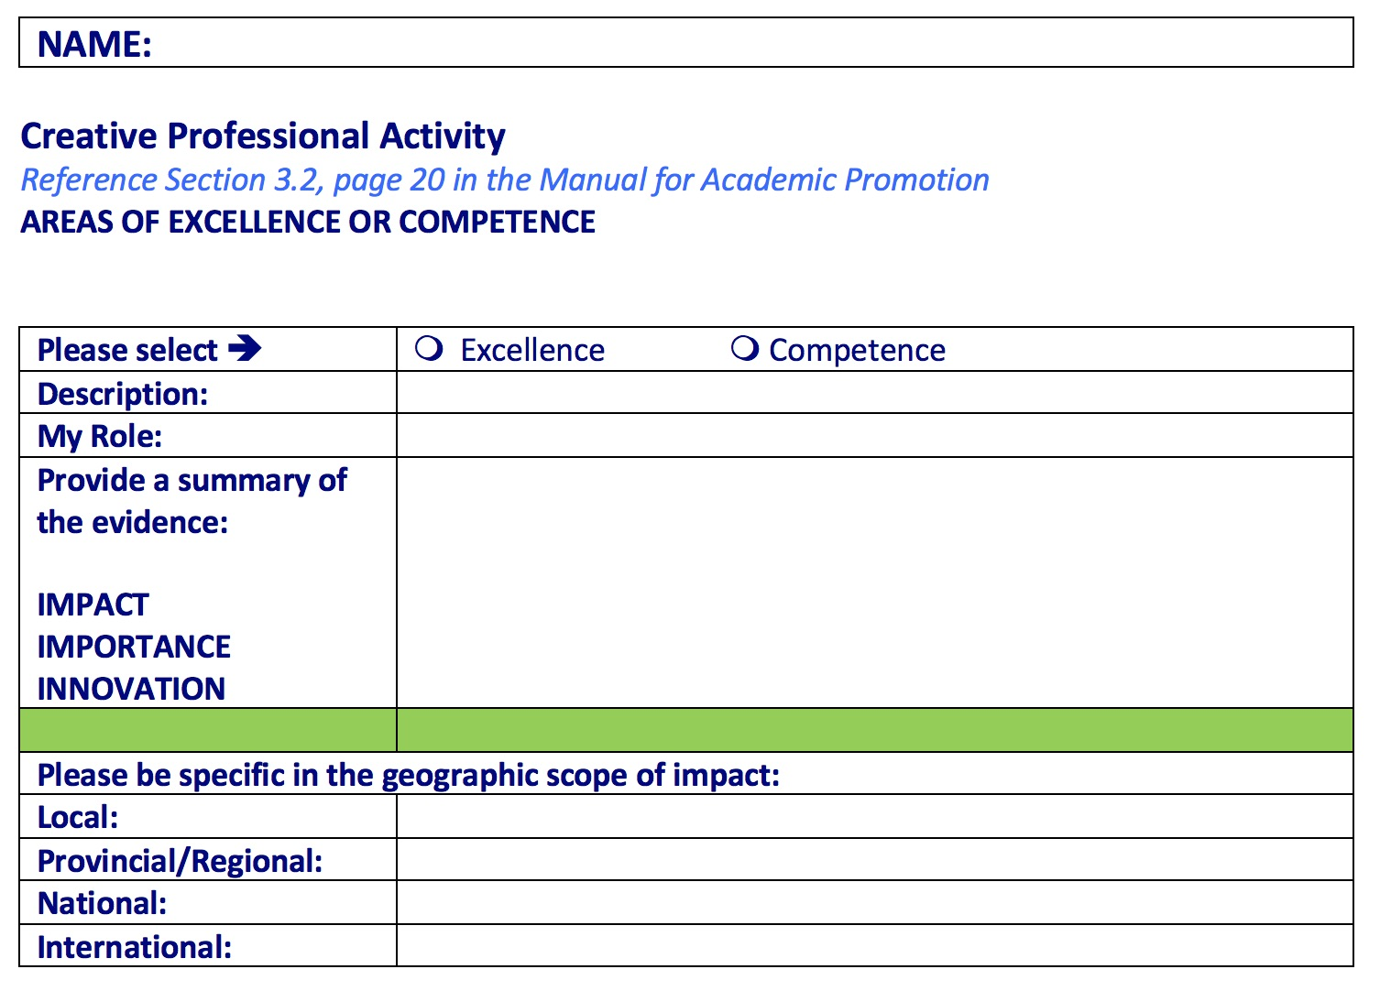
CPA – PRE-APPLICATION
Provide a summary of the evidence of creativity, innovation, excellence, and impact
Notes:
Dr. Antao

Slide 18
TEACHING & EDUCATION
All promotion candidates must demonstrate competence in teaching.
To establish EXCELLENCE, there must be evidence of some combination of the following:
Successful innovations in the teaching domain (creation of significant/innovative teaching processes, materials, and forms of evaluation
Nomination for or receipt of awards/honours
TES above the acceptable standard for the dept.
Development of significant new courses and/or reform of curricula
Development of new technology in teaching
Using one’s expertise to deepen student
Etc…
To establish COMPETENCE, there must be evidence of:
Mastery of the subject area and strong communication skills
Ability to stimulate and challenge students
Being accessible to students inside/outside classroom
Fair and ethical dealings with students recognizing diverse needs and backgrounds
Use meaningful methods of assessment
Ensure course content reflects current and relevant research and practice in the field
Etc…
PROMOTIONS MANUAL
PG 27 (under “GROUP ONE”)
Notes:
Dr. Antao

Slide 19
WAIVER OF EXTERNAL REVIEW
Reminder from workshop #1…
If you will you have sustained “excellence” in
teaching & education ONLY:
A Waiver of External Review recognizes that some faculty spend a large portion of time in clinical work & teaching rather than scholarship and therefore are NOT necessarily known nationally or internationally. This Waiver should not be used for a candidate where research/CPA is an important part of the evaluation.
In this case, INTERNAL referee letters (not EXTERNAL) are solicited in order to provide a Faculty of Medicine/University of Toronto context.
IMPORTANT: this must be identified early in the process – ideally in your pre-application.
WAIVER PROCESS
identified in pre-application & supported by DPC
DFCM will submit a request to the Dean
Request will include following items:
Letter of support from Chair
Teaching statement
CV
Teaching Dossier
Data summary report
Approval from Dean granted (typically only takes a few days)
Candidate moves forward with dossier
Notes:
Dr. Antao

Slide 20
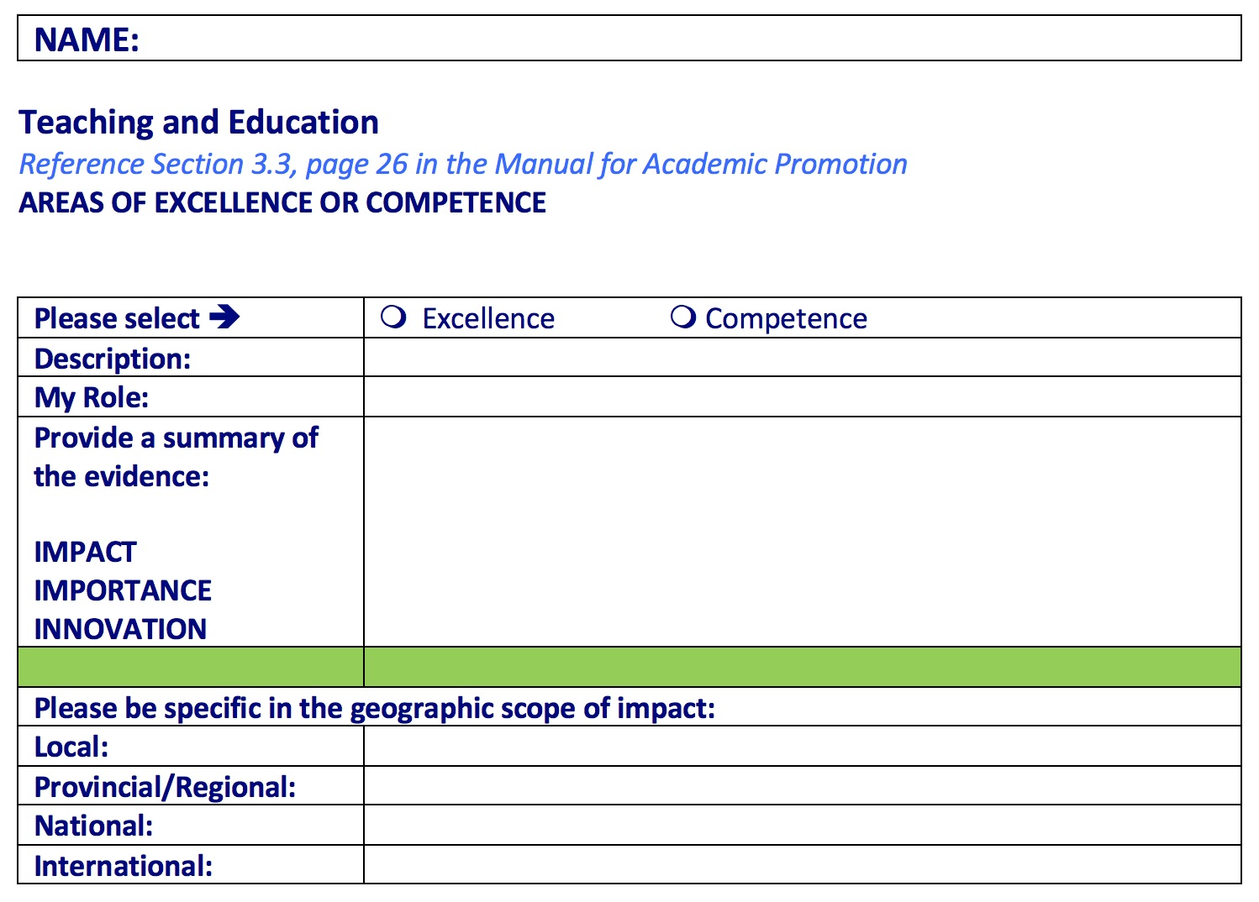
TEACHING & EDUCATION - PREAPPLICATION
Provide a statement of your approach to teaching, including an assessment of the impact of teaching activities.
Notes:
Dr. Antao

Slide 21
ADMINISTRATIVE SERVICE
Administrative Service in itself cannot be the main criteria
You do not have to claim “excellence” or “competence” here
Service to the University means primarily administrative or committee work within the University
Consideration will also be given to activities outside the University, which further the scholarly and educational goals of the University.
i.e. service to the professional, clinical or research discipline (president of national or international orgs, committee chair, conference organizer, policy development
Service to municipal, provincial, or federal governments or non-government orgs
PROMOTIONS MANUAL
PG 40
Notes:
Dr. Antao

Slide 22
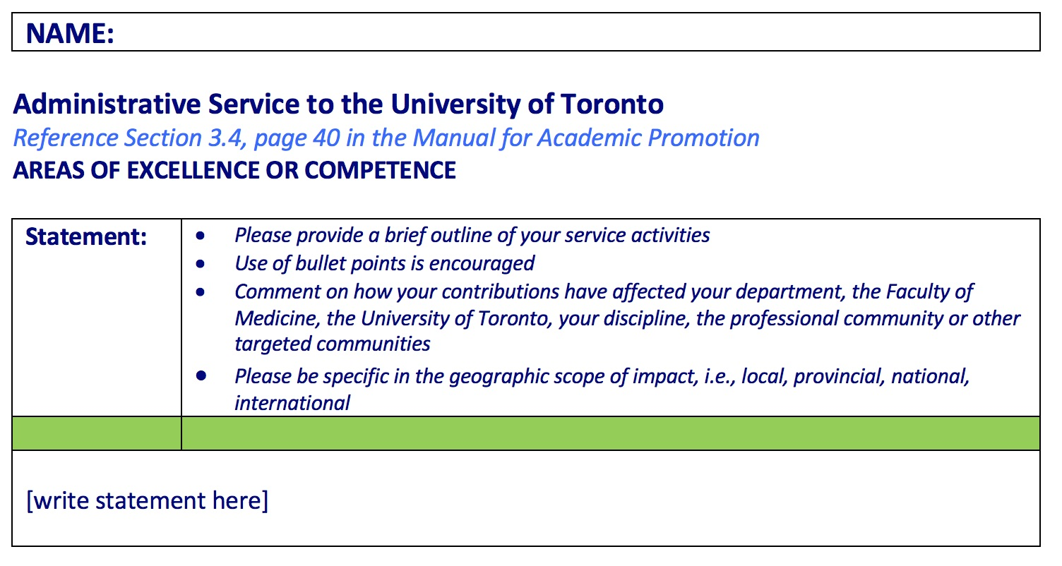
ADMINISTRATIVE SERVICE – PRE-APPLICATION
Provide a statement of your service activities – use bullet points
Notes:
Dr. Antao

Slide 23
You are required to provide 5 scholarly pieces of work and/or publications in your senior promotion.
You must clearly state in your pre-application the significance and geographic scope of impact:
Local
Provincial
National
International
Remember, in order to establish wide-reputation:
Associate professor = national
Professor = international
5 SCHOLARLY PIECES OF WORK AND/OR
PUBLICATIONS
Notes:
Dr. Antao

Slide 24
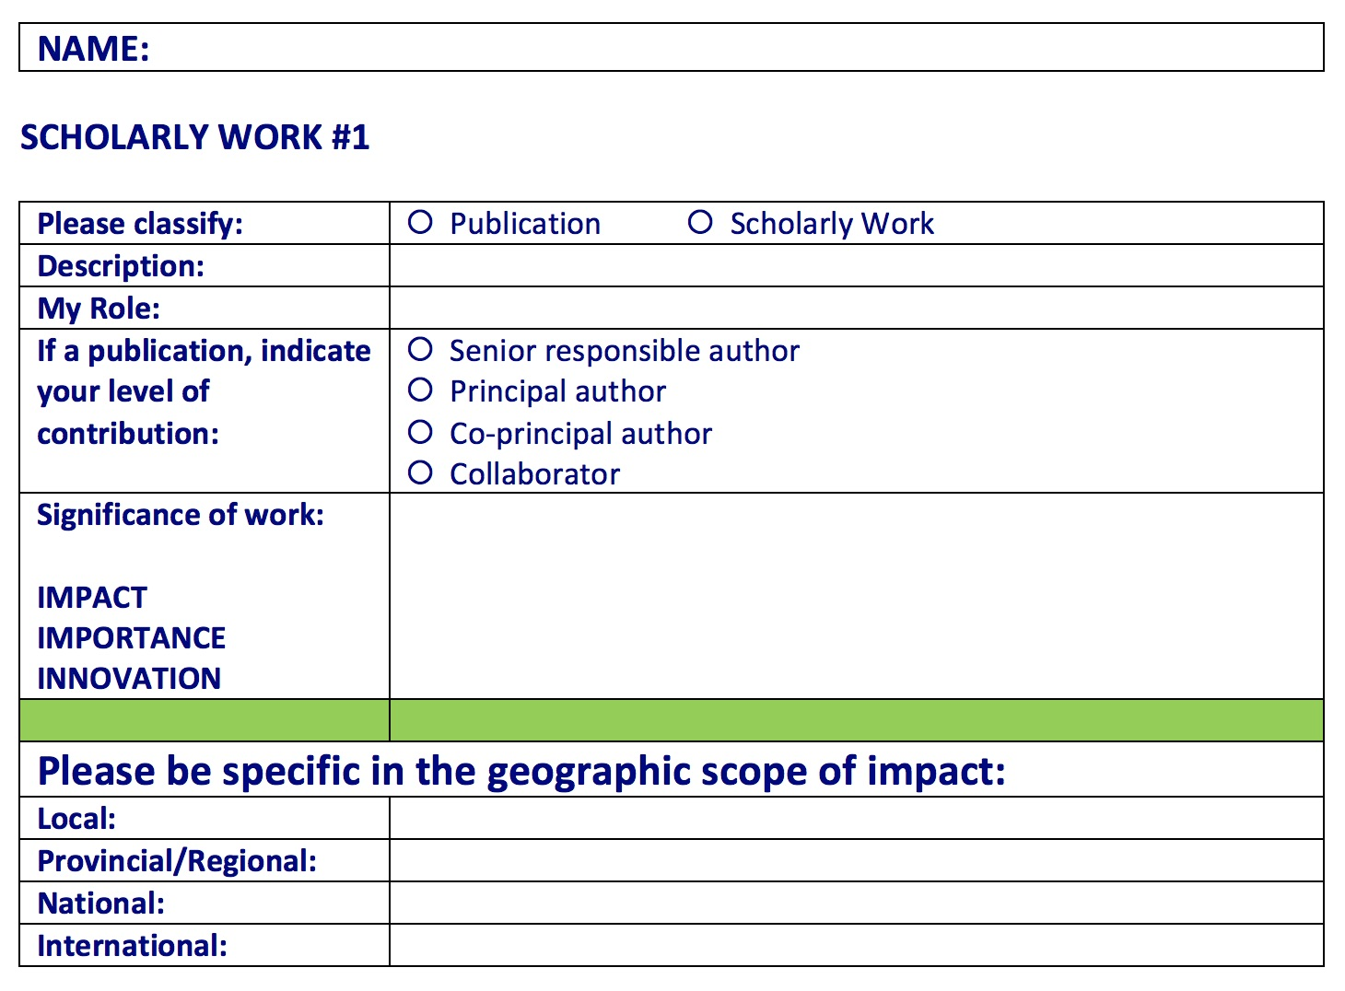
Each scholarly work/publication listed in your pre-application will look like this:
5 SCHOLARLY PIECES OF WORK AND/OR
PUBLICATIONS
CLEARLY STATE
Notes:
Dr. Antao

Slide 25
PRE-APPLICATION – TEACHING DOSSIER
Teaching Dossier
A sample teaching dossier is provided in the pre-application package
Your TD should be an account of all teaching since your last date of promotion
Teaching Data Summary Report - Teaching Effectiveness Score (TES)
A summary of your teaching effectiveness scores are required with the pre-application package
If you are claiming “excellence” in teaching, please ensure your teaching dossier and TES report are accurate and up-to-date
For the purpose of the pre-application, you do NOT have to provide a teaching statement or copies of your evaluations, PowerPoint presentations, award letters or certificates.
Please use the TEACHING DATA SUMMARY TABLE provided with the pre-application package.
If you do not have copies of your Teaching Effectiveness Scores, your first point of contact to receive your evaluations is your Chief/DFCM Division Head.
Notes:
Dr. Antao

Slide 26
REMEMBER…
ONLY academic work since your LAST DATE OF PROMOTION “counts” towards your senior promotion.
Your CV should be a FULL record of your career.
Notes:
Dr. Antao

Slide 27
Thank you!
Questions?
Notes:
Questions about presentation before breakout rooms

Slide 28
3:30 – 4:15 (45 min)
Guest faculty:
Dr. Rahim Moinnedin – Research
Dr. Allan Grill – CPA
Dr. George Porfiris – Teaching & Education
Dr. David White
Department Promotions Committee Chair
Dr. Viola Antao
Faculty Development Program Director
DISCUSSION & REVIEW
Use this opportunity to:
Ask questions specific to YOUR pre-application
Hear other candidate’s questions
Seek advice on areas of excellence & competence
Help identify accomplishments of scholarship
Consult on your 5 pieces of scholarly work/pubs
Referencing the promotions manual
Considering waiver of external review?
Tips, tricks and helpful hints from experienced faculty

Slide 29
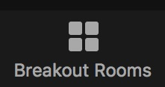
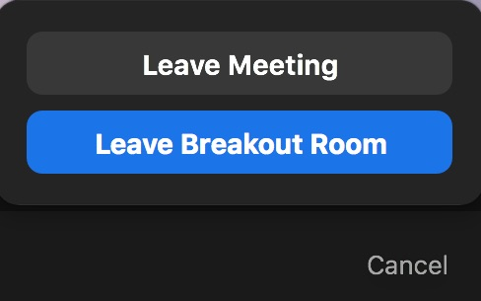
Instructions - please read fully
3:30 – 4:15: BREAKOUT ROOMS
You may CHOOSE which breakout room to enter.
Simply click on “BREAKOUT ROOMS” in your bottom menu →
HOVER YOUR MOUSE over the room, and click “JOIN”.
Be PATIENT – it takes a minute for you to get there and for others to join.
You may also move from one room to another by clicking “JOIN” on another room in the breakout list.
4:15 – 4:30: GROUP DEBRIEF IN MAIN MEETING
The breakout rooms will CLOSE at 4:15 and everyone will automatically be returned to the
main meeting for a group debrief.
(FYI) If you click the “LEAVE MEETING” button at the bottom right corner of your menu →
it will give you the option to:
LEAVE BREAKOUT ROOM (and return to main meeting) OR
LEAVE MEETING ENTIRELY
If you need assistance,
Let us know

Slide 30
DEBRIEF
Read the promotion manual
Book dedicated time
Review pre-application SAMPLES
(provided by request: dfcm.promotion@utoronto.ca)
Make sure your CV & Teaching Dossier are updated
Collect TES → data summary table
Try to secure administrative support if possible
Notes:
Dr. Antao

Slide 31
1. SUBMIT YOUR PRE-APPLICATION: APRIL 30, 2021
Applications should be submitted electronically to Sarah Letovsky by email: dfcm.promotion@utoronto.ca
Make sure you’re following the pre-application SUBMISSION FORMAT
(in 1 PDF file - full submission instructions provided on page 1 of the pre-application template)
Review carefully and ensure ALL the items are included
2. RECOMMENDATION & FEEDBACK FROM THE DPC
Following review by the Department Promotions Committee (DPC), a formal letter will be sent to the candidate providing the recommendations along with feedback specific on the application and academic activities.
3. WORKSHOP #3: May 28, 2021 – 2:30 – 4:30pm
Please reserve this time in your schedule
Registration link to be sent to confirmed candidates only
This workshop will outline the components of the full promotion dossier
Overview of important documents such as the letter to the Chair, and reflective statement
NEXT STEPS
Notes:
Sarah

Slide 32
FINAL QUESTIONS?
Thank you for joining us!
Please tell us how we did – feedback survey to be sent via email
Visit our website for promotion resources:
https://www.dfcm.utoronto.ca/senior-promotion
Notes:
Final Questions & Thanks

